Slide 1
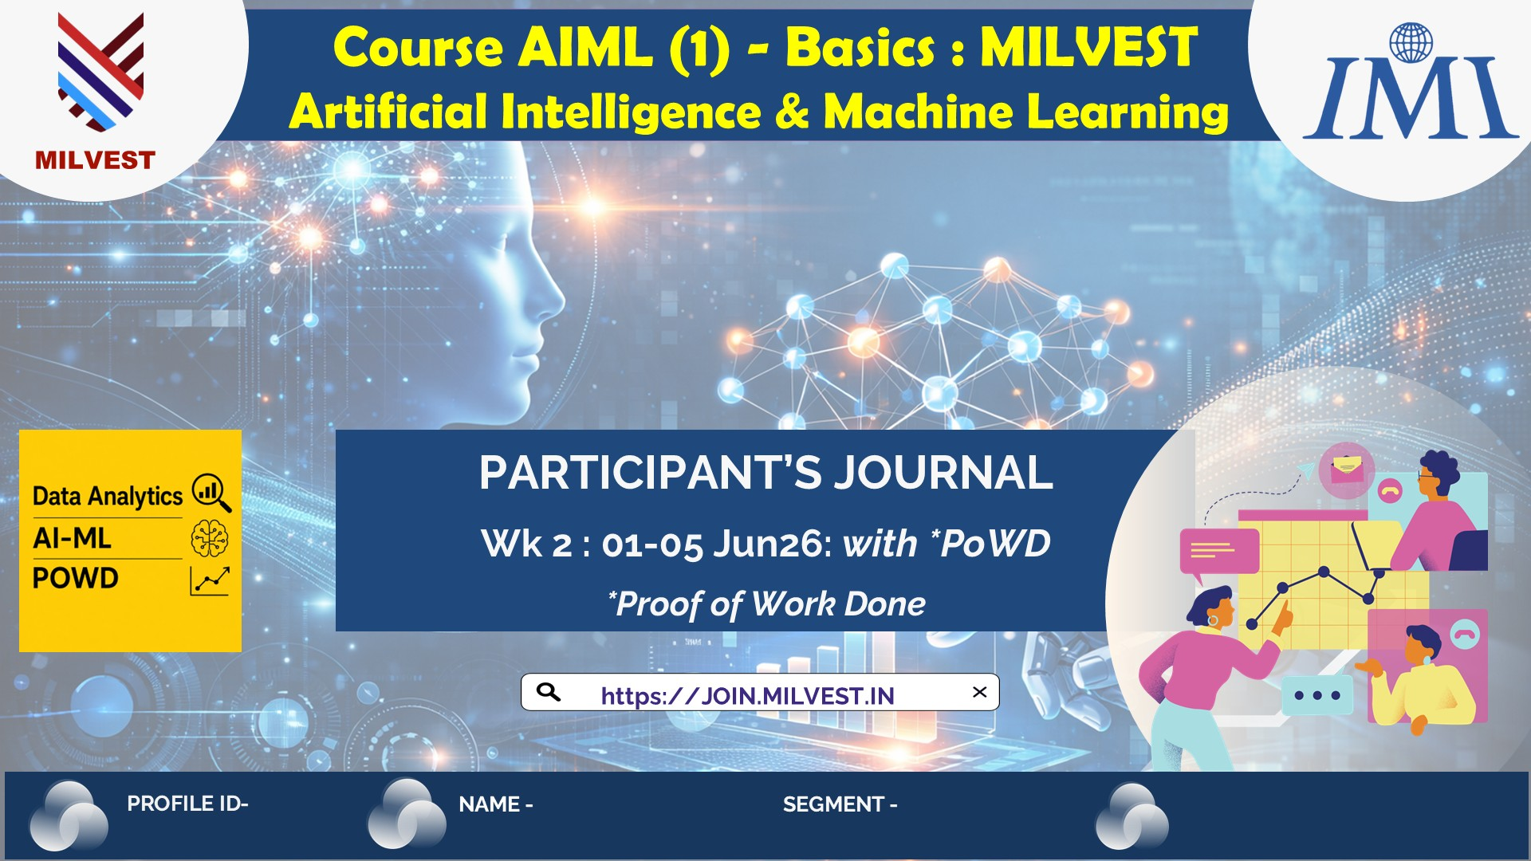
PROFILE ID – 2014381 NAME – ASHA SEGMENT – TEJASVINI

Slide 2
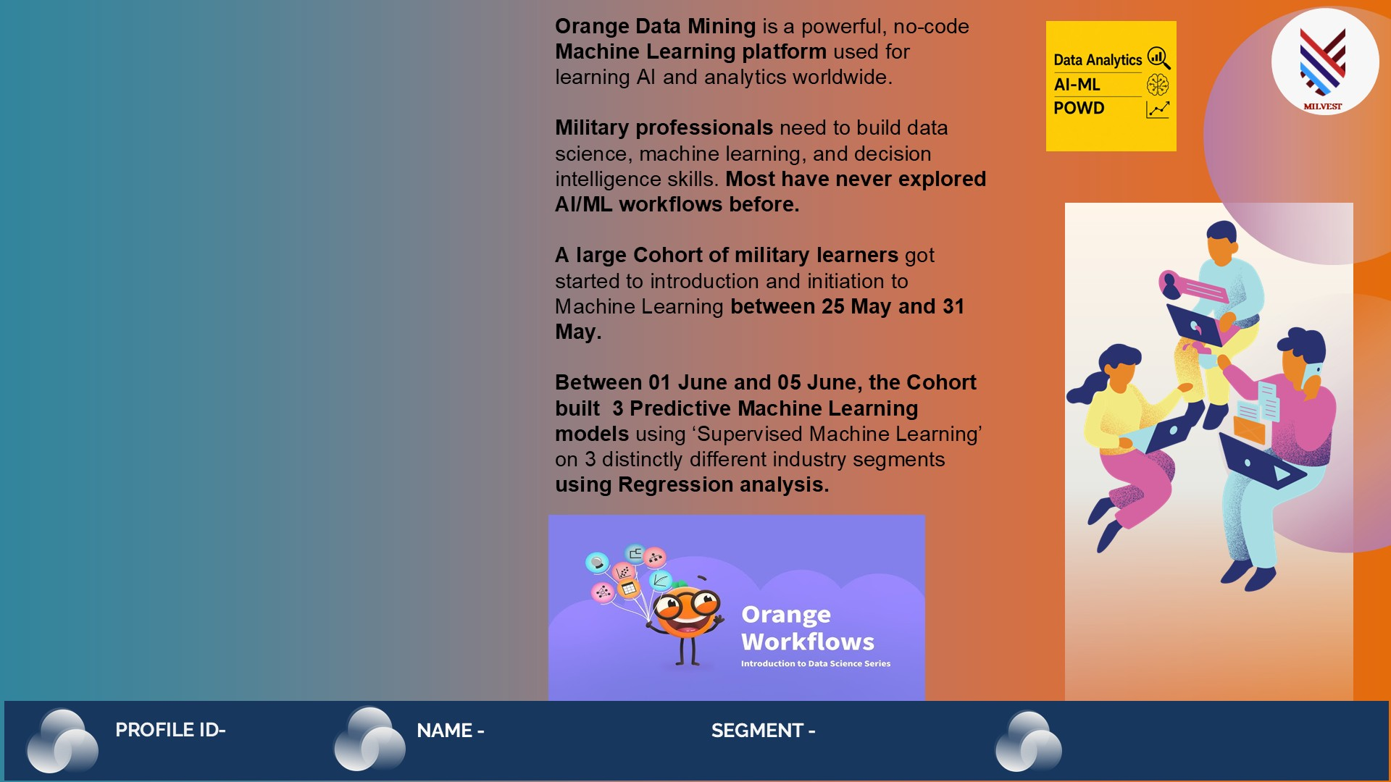
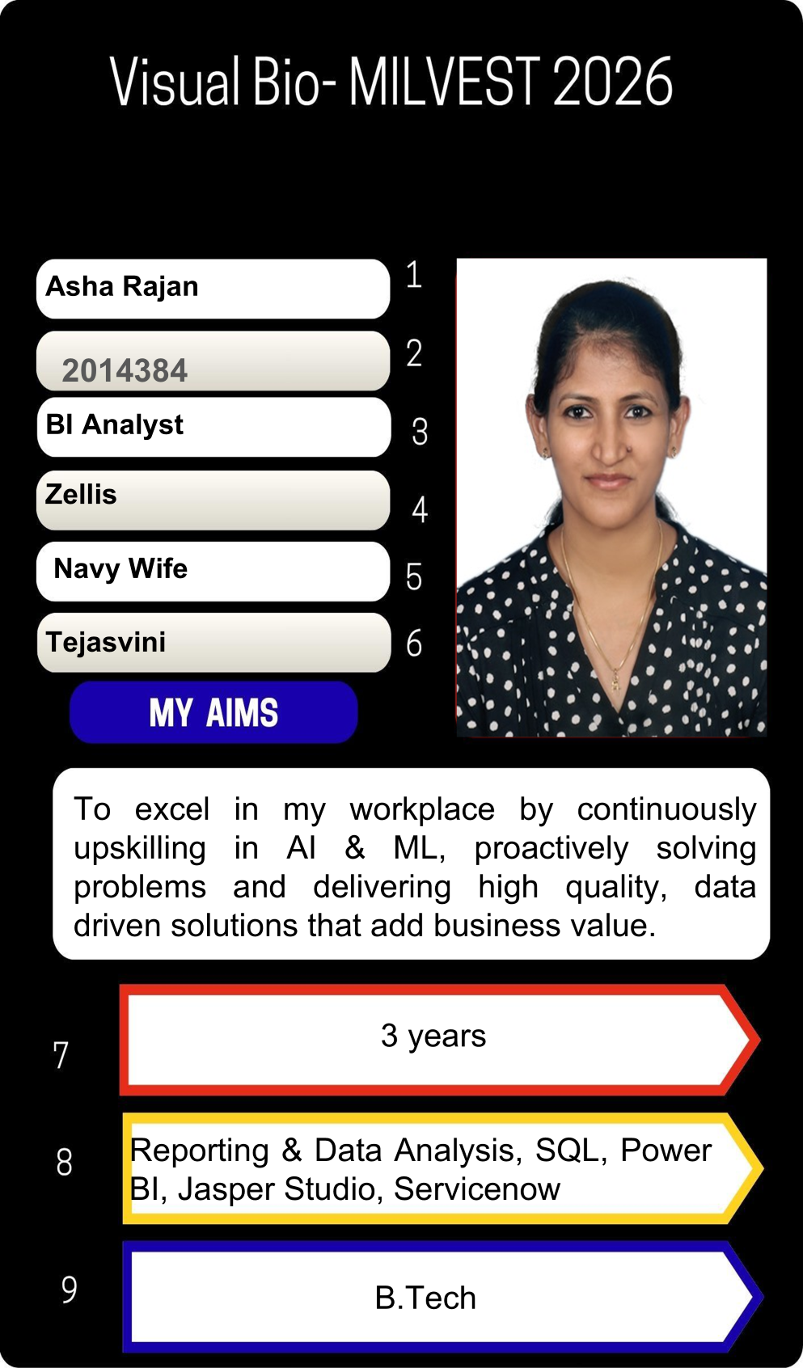
PROFILE ID – 2014381 NAME – ASHA SEGMENT – TEJASVINI

Slide 3
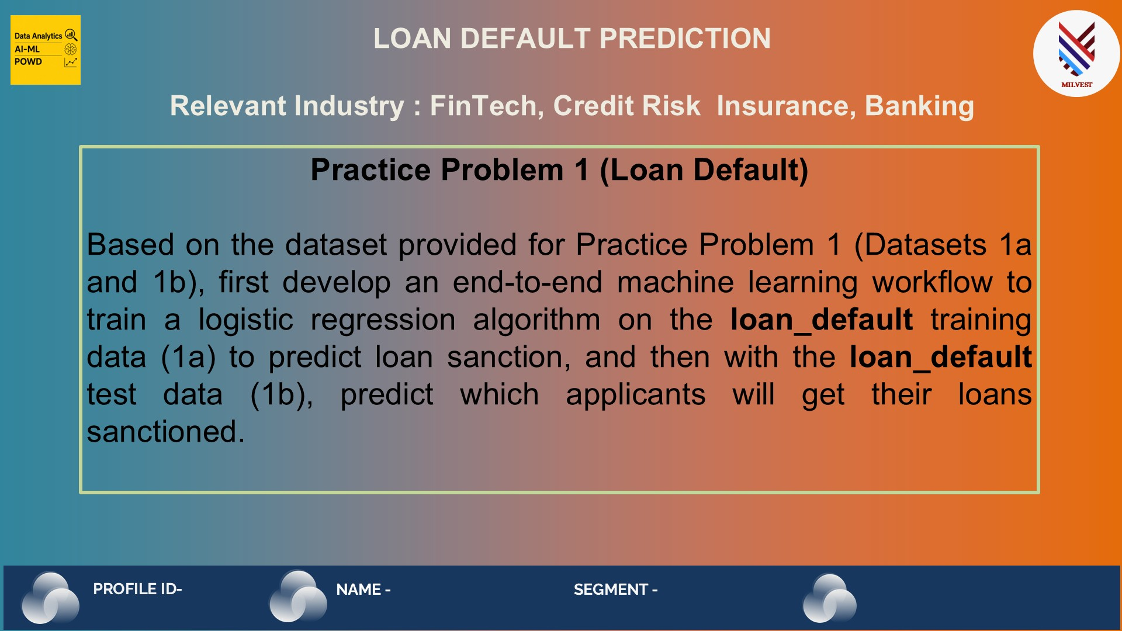
PROFILE ID – 2014381 NAME – ASHA SEGMENT – TEJASVINI

Slide 4
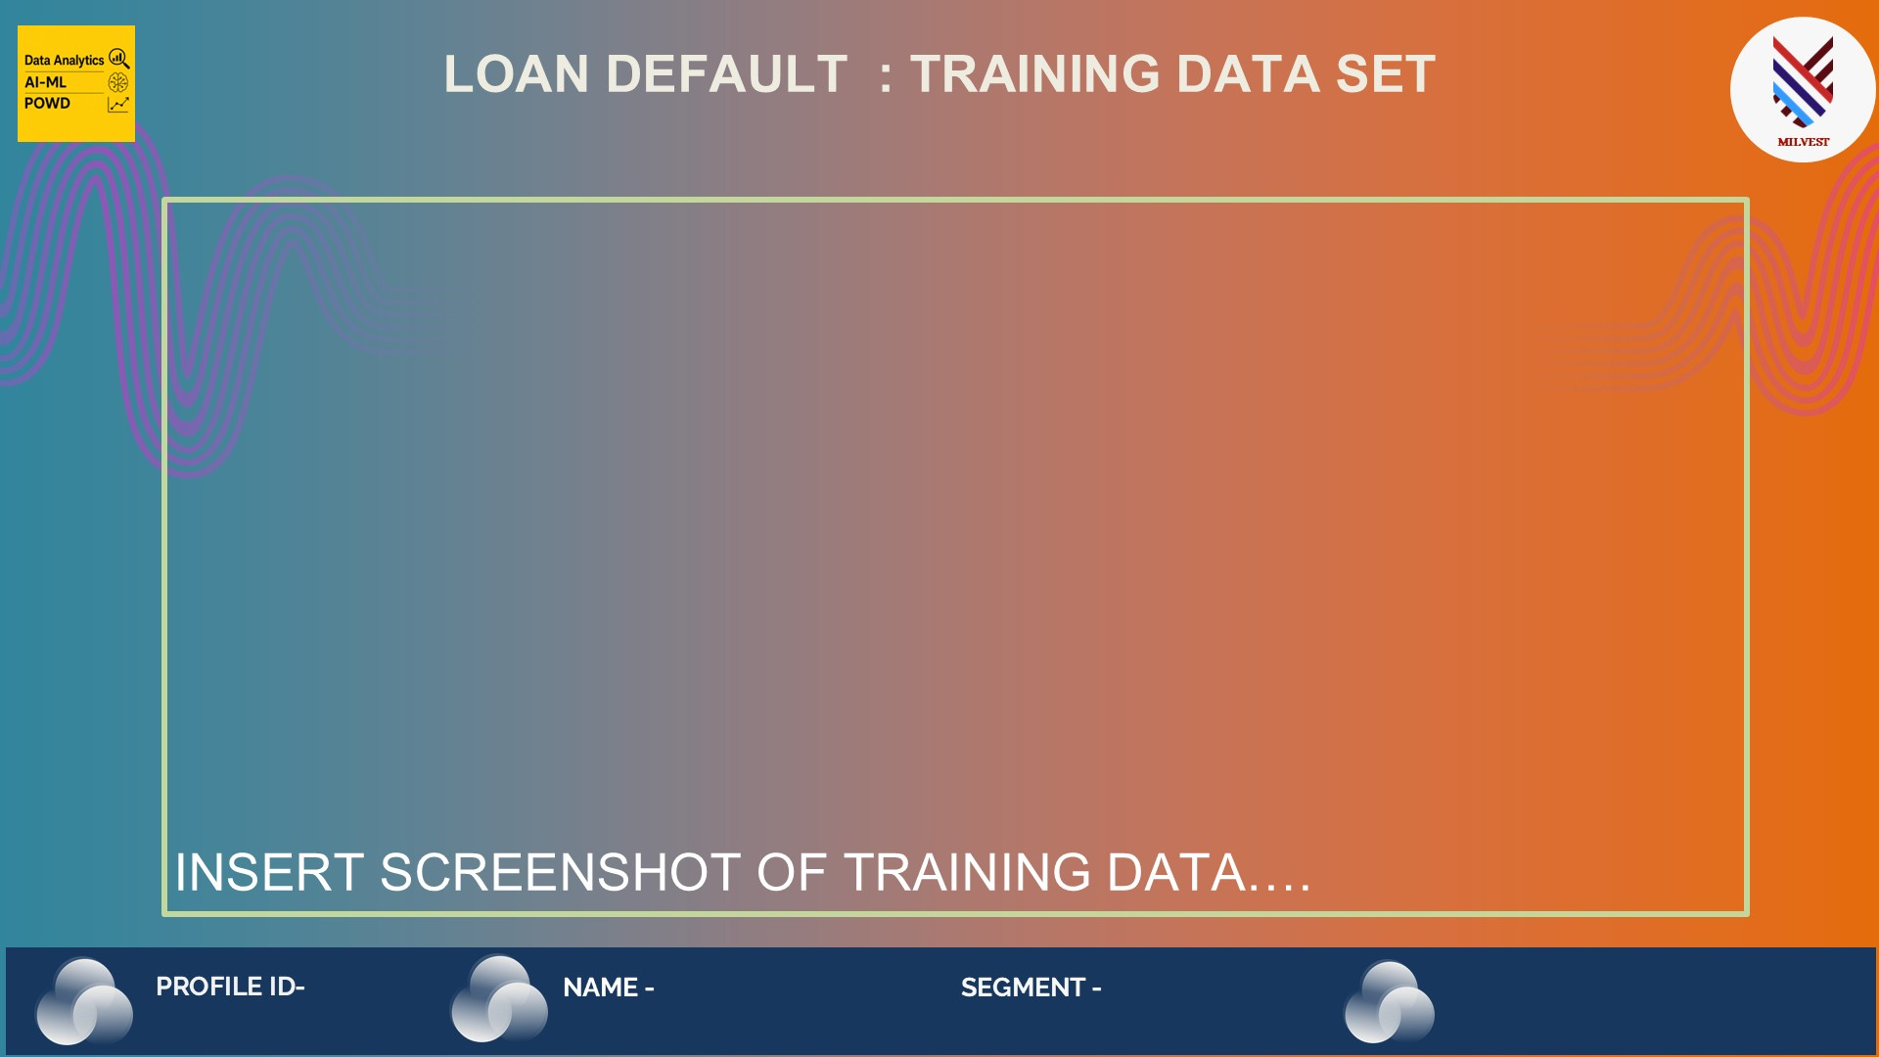
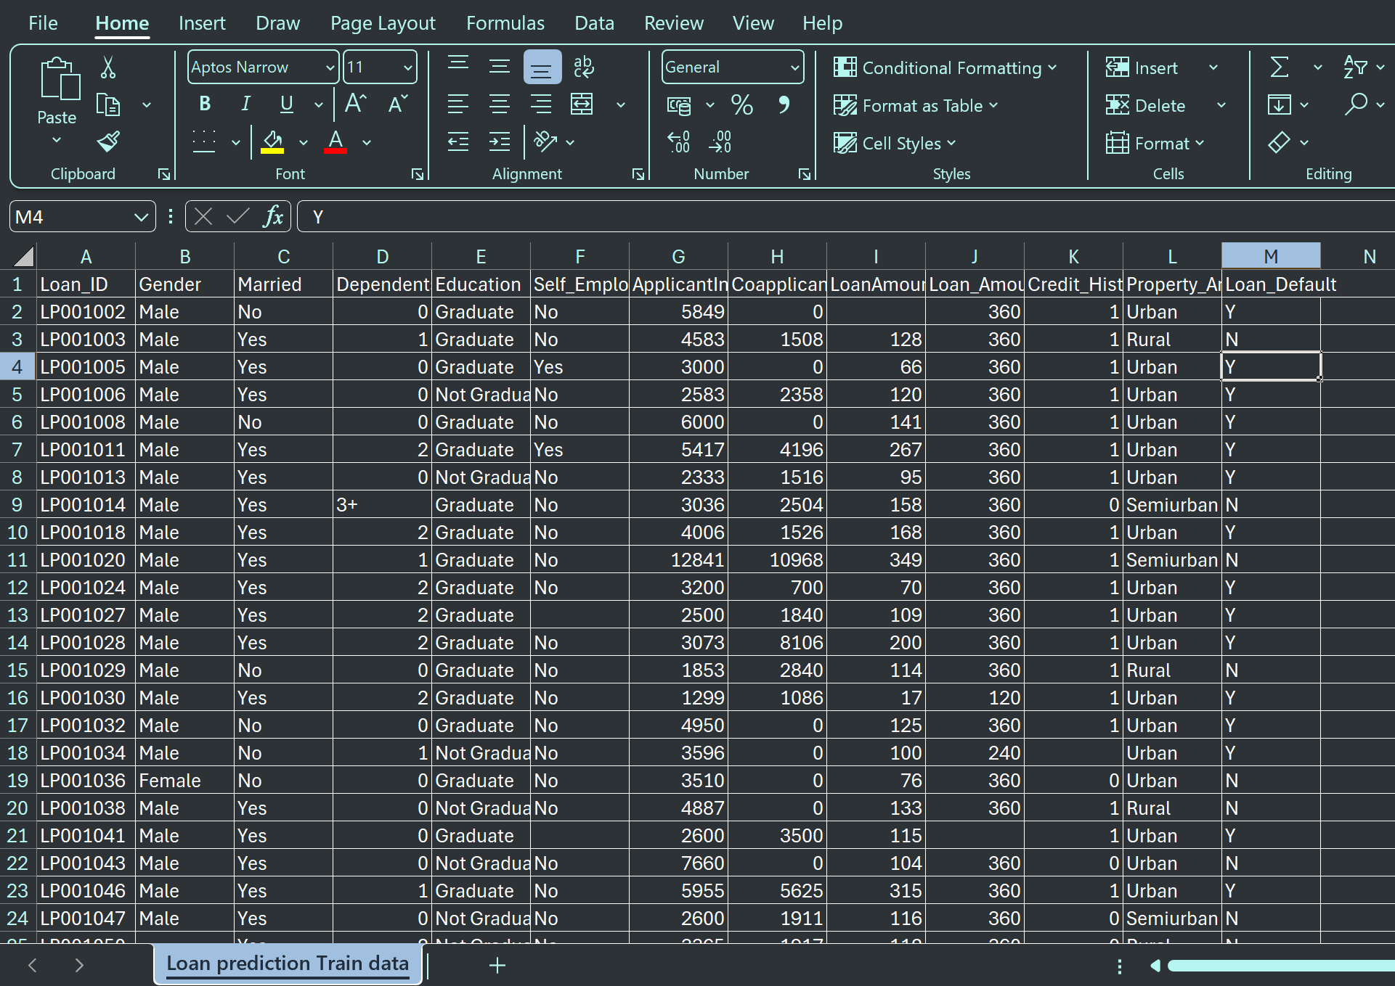
PROFILE ID – 2014381 NAME – ASHA SEGMENT – TEJASVINI

Slide 5

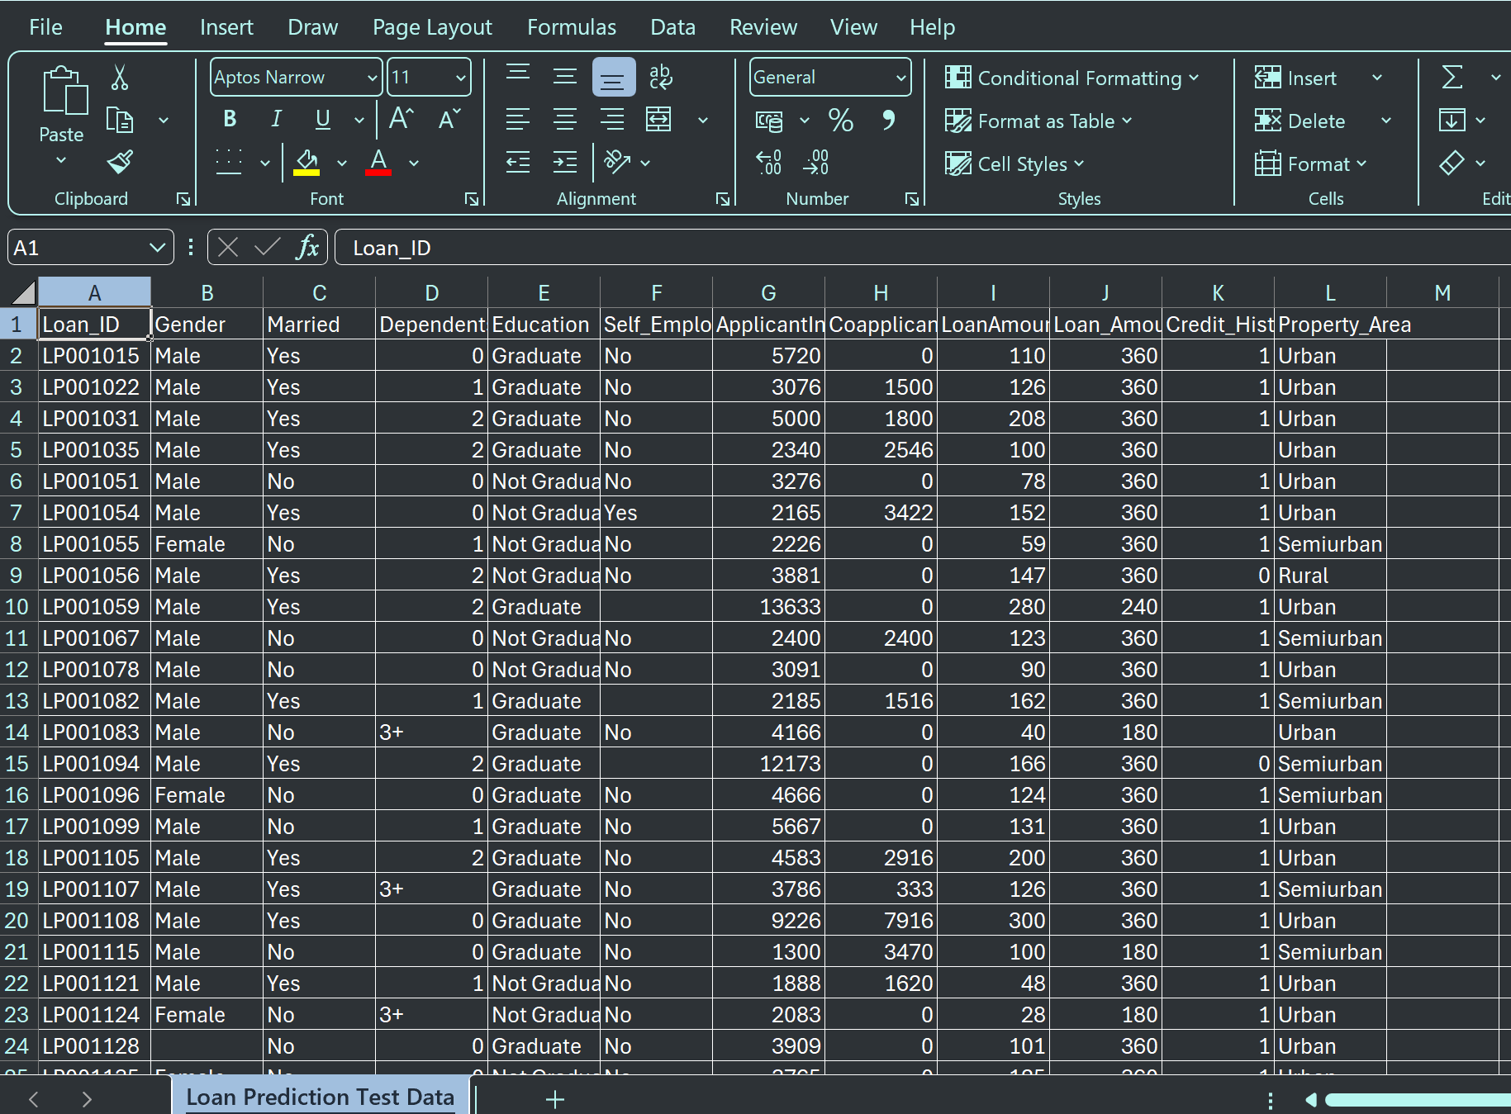
PROFILE ID – 2014381 NAME – ASHA SEGMENT – TEJASVINI

Slide 6
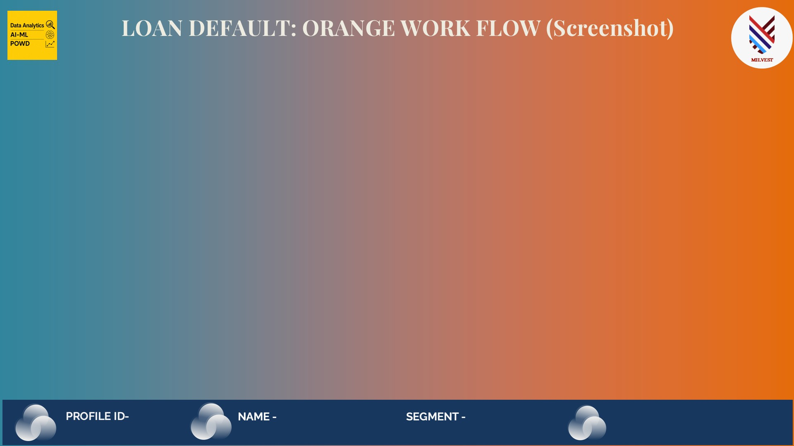
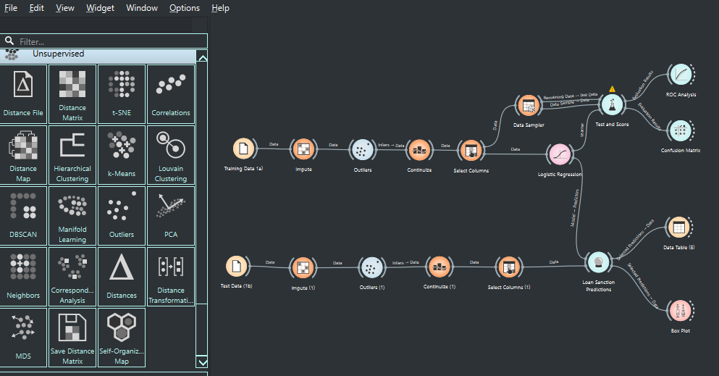
PROFILE ID – 2014381 NAME – ASHA SEGMENT – TEJASVINI

Slide 7
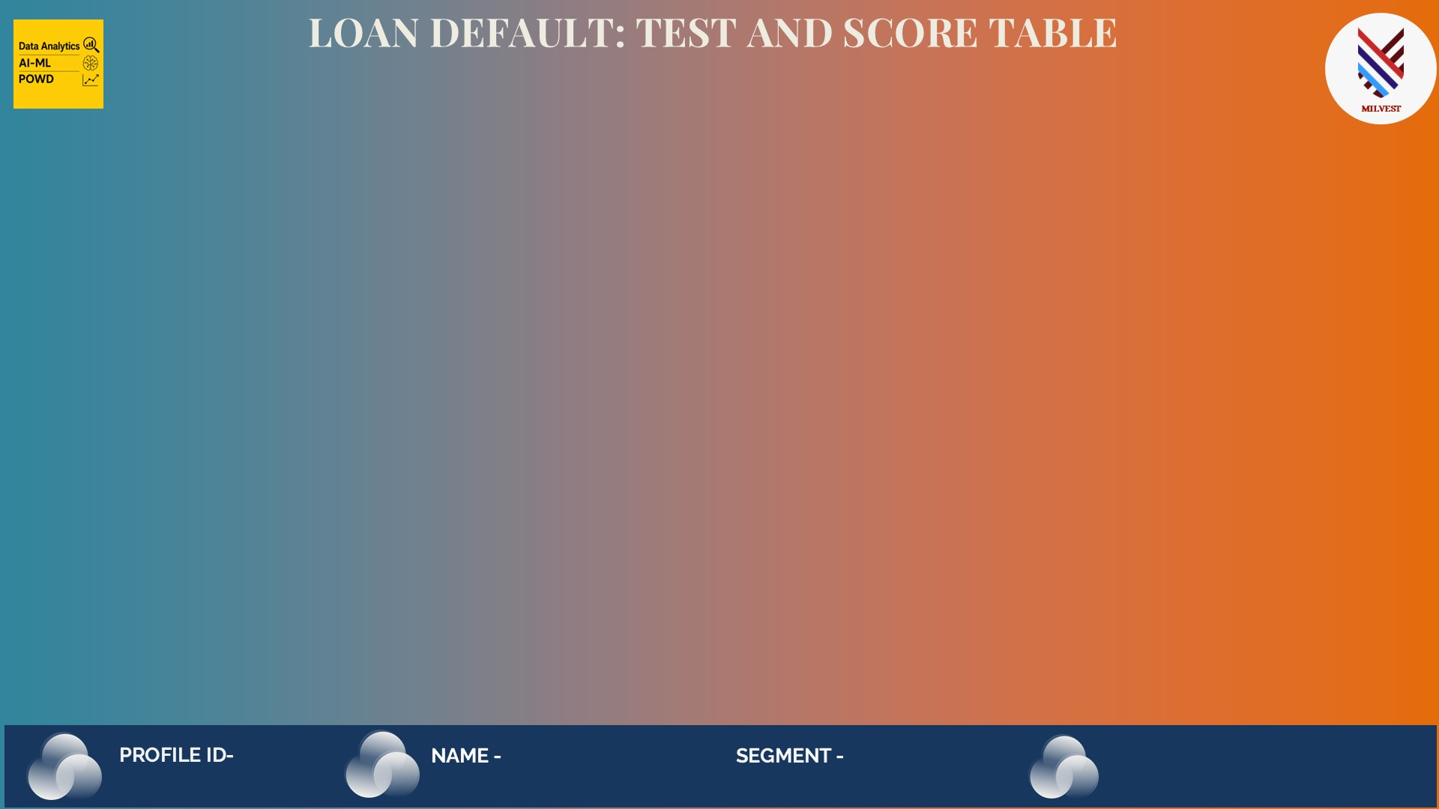
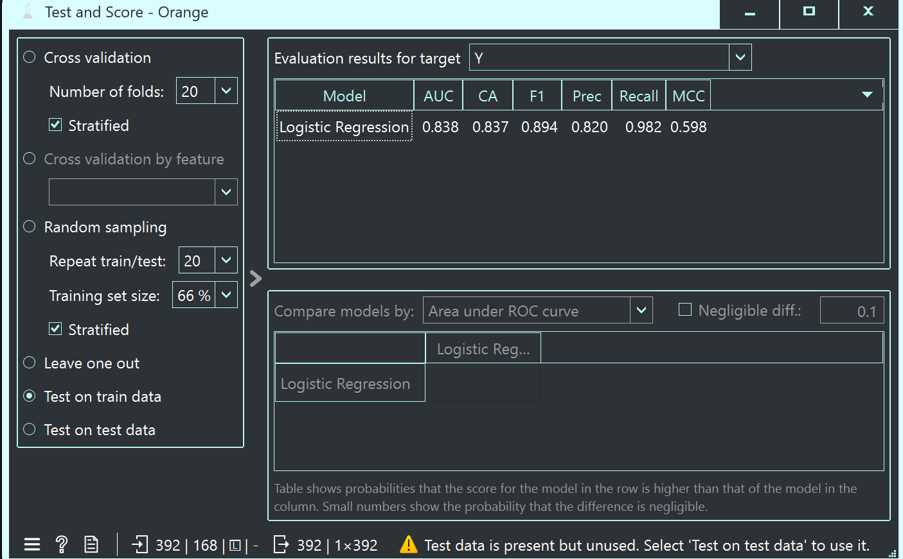
PROFILE ID – 2014381 NAME – ASHA SEGMENT – TEJASVINI

Slide 8

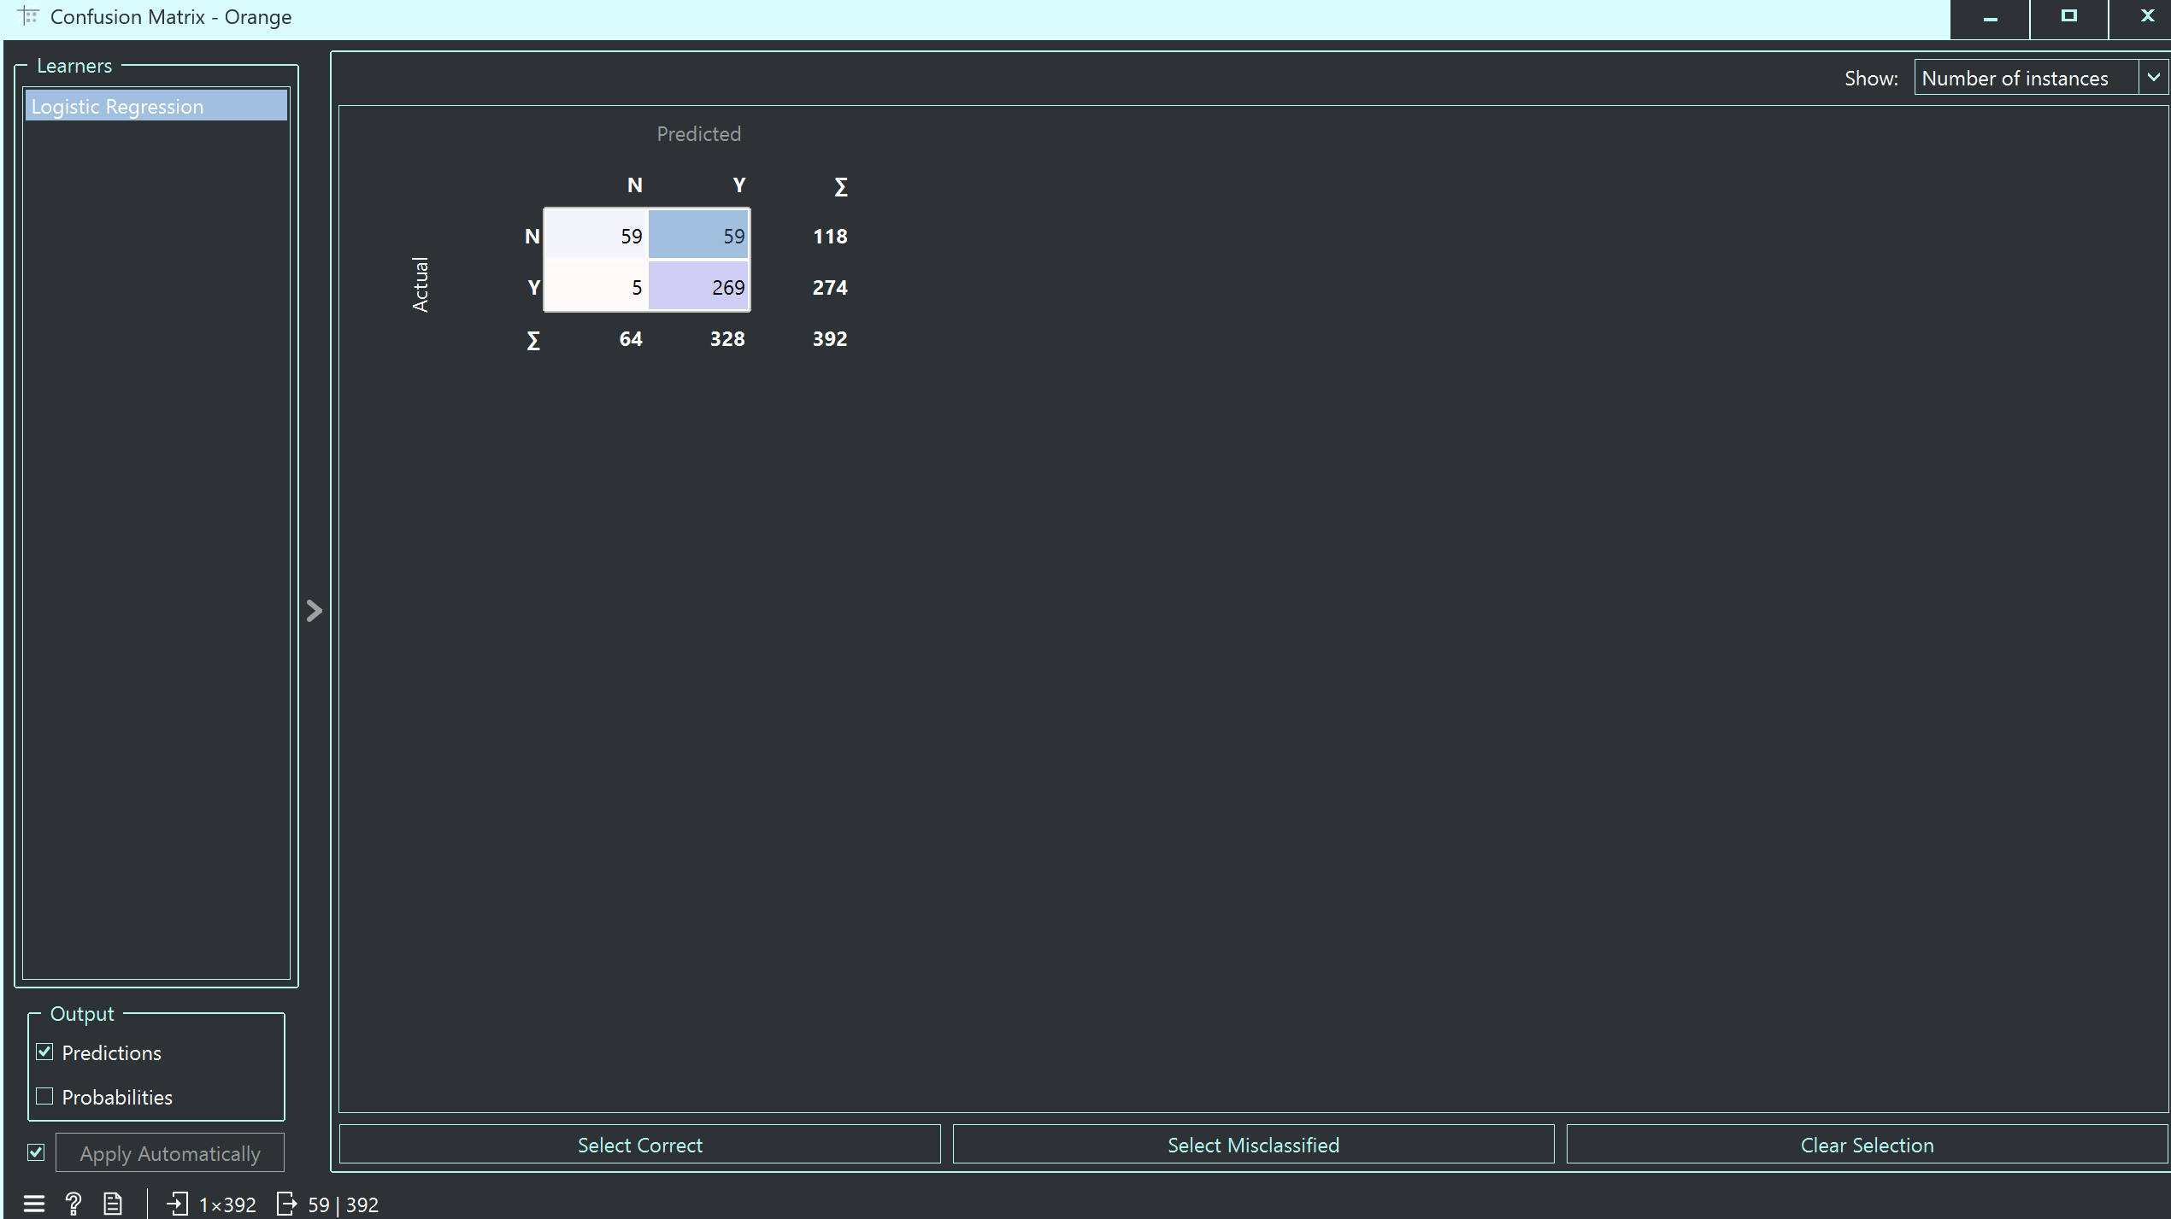
PROFILE ID – 2014381 NAME – ASHA SEGMENT – TEJASVINI

Slide 9

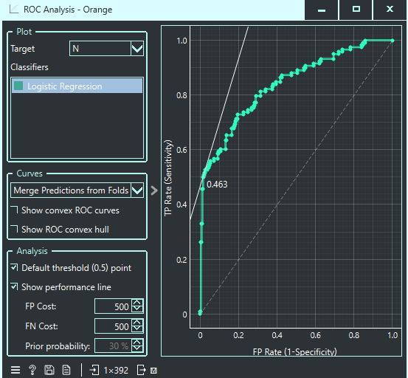
PROFILE ID – 2014381 NAME – ASHA SEGMENT – TEJASVINI

Slide 10
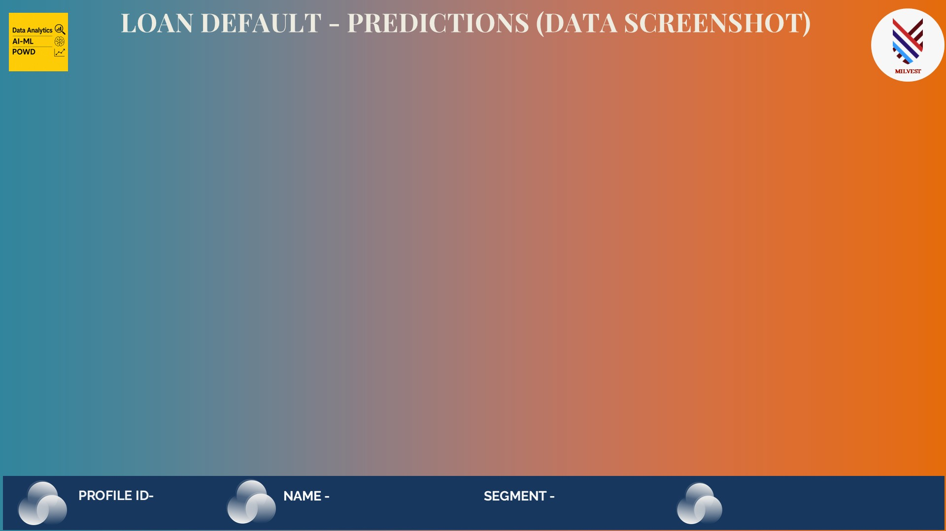
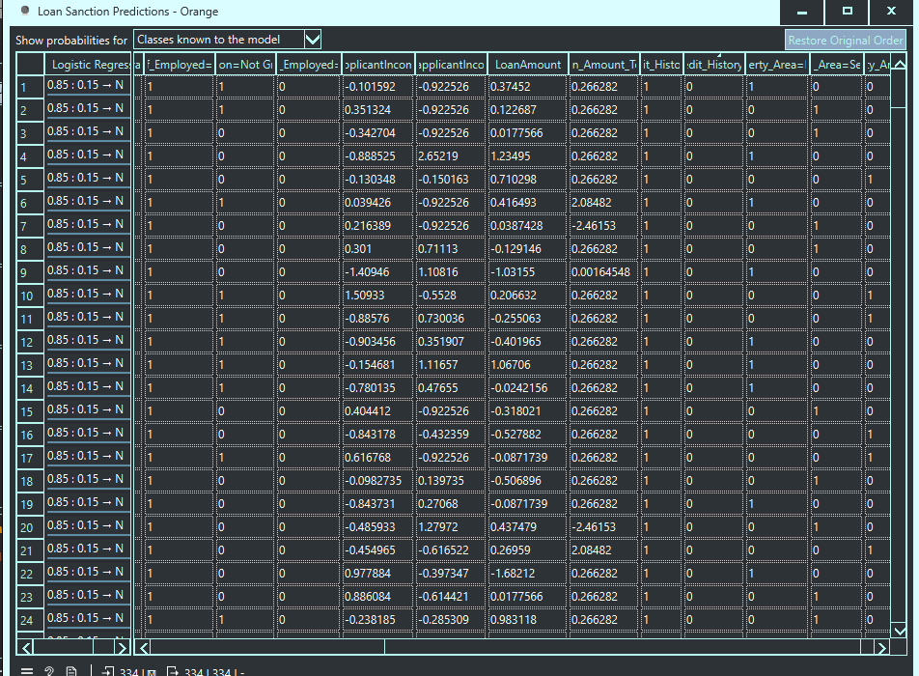
PROFILE ID – 2014381 NAME – ASHA SEGMENT – TEJASVINI

Slide 11

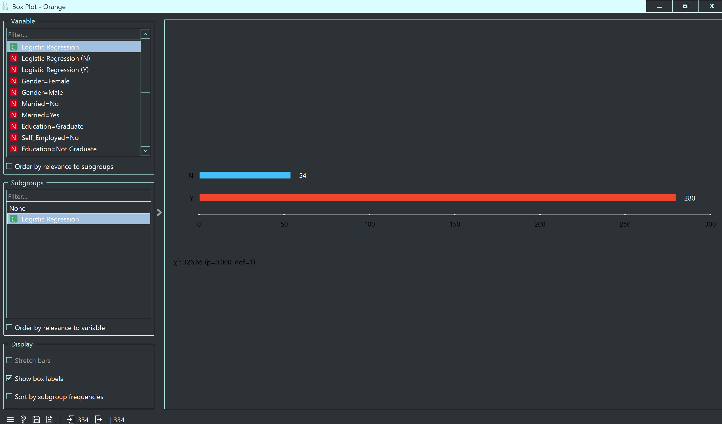
PROFILE ID – 2014381 NAME – ASHA SEGMENT – TEJASVINI

Slide 12
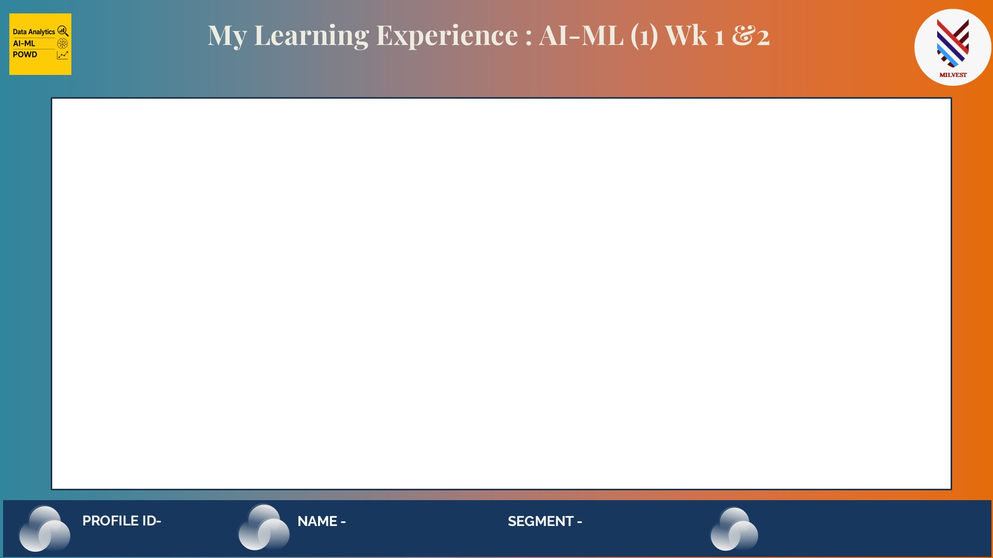
What I explored:
Was introduced to Orange Data Mining — a no-code, visual ML platform
Learned the concept of Supervised Machine Learning and how algorithms learn from labelled data
Understood the difference between classification and regression problems
What I built:
Completed my first end-to-end ML workflow using Logistic Regression on the Loan Default dataset
Loaded, cleaned and preprocessed real world banking data
Handled missing values using Impute, removed anomalies using Outliers and encoded fields using Continue
Predicted loan sanction outcomes using the trained model
My biggest insight:
Data preprocessing is more important than the algorithm itself
PROFILE ID – 2014381 NAME – ASHA SEGMENT – TEJASVINI

Slide 13

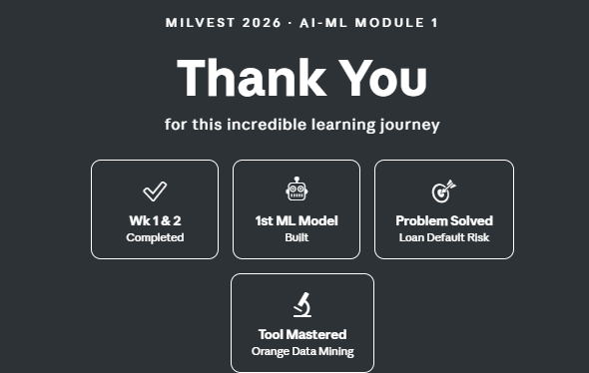
PROFILE ID – 2014381 NAME – ASHA SEGMENT – TEJASVINI

